Slide 1
Create your own Super Touchpoints slide

Slide 2
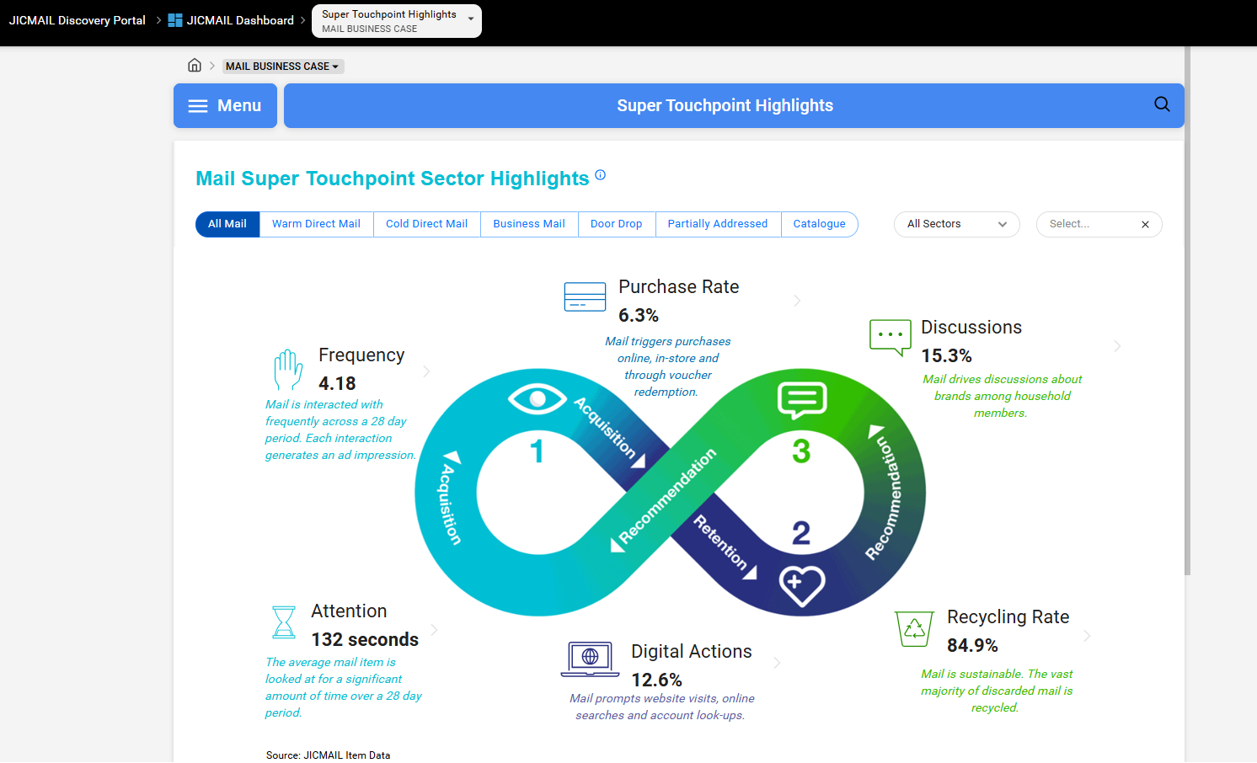
Create your own Super Touchpoints slide
You can now create your own Super Touchpoints slide in JICMAIL Discovery
Use the filters to choose mail type, sector and time span
Include in your pitch decks for the latest JICMAIL data

Slide 3
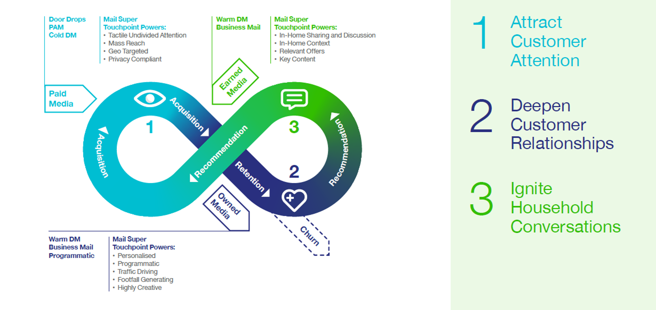
Mail has impact throughout the customer journey

Slide 4
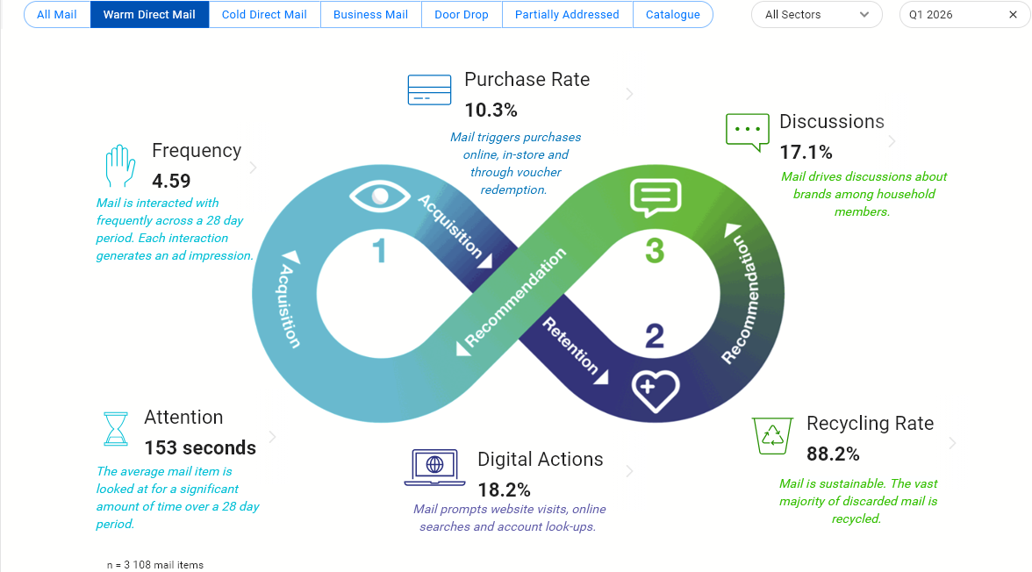
Warm Direct Mail’s Super Touchpoint Strengths in Q1 2026
Source: JICMAIL Item Data Q1 2026

Slide 5
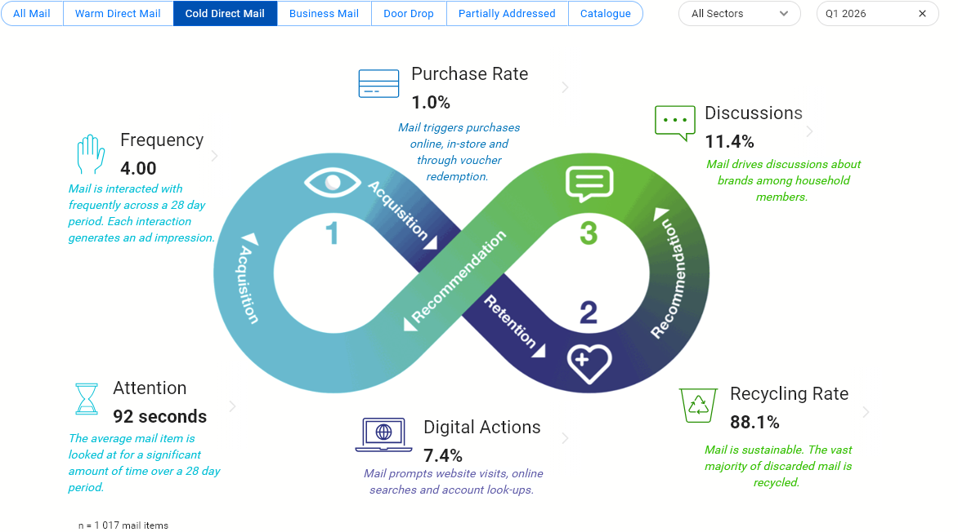
Cold Direct Mail’s Super Touchpoint Strengths in Q1 2026
Source: JICMAIL Item Data Q1 2026

Slide 6
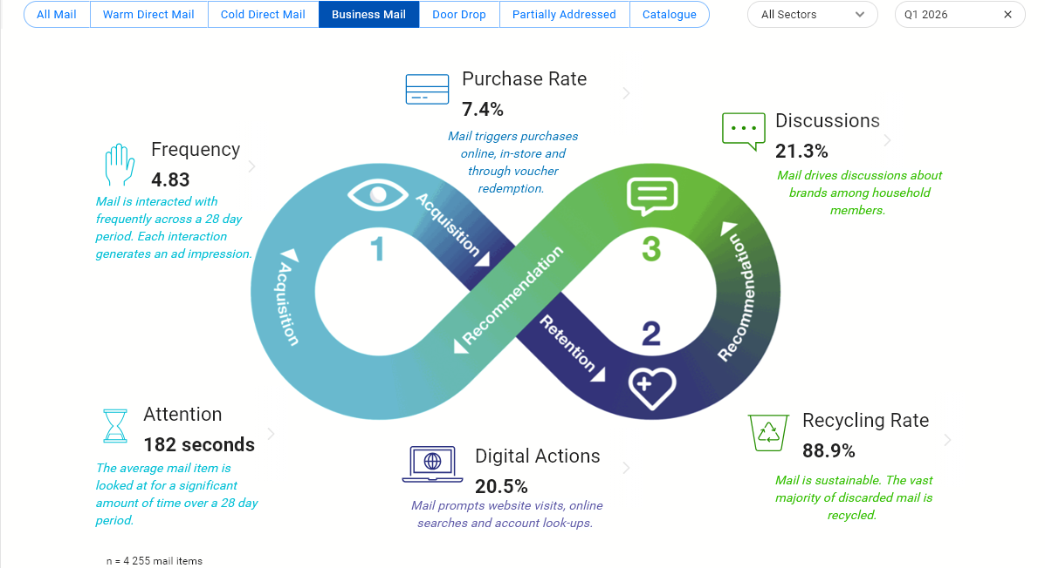
Business Mail’s Super Touchpoint Strengths in Q1 2026
Source: JICMAIL Item Data Q1 2026

Slide 7
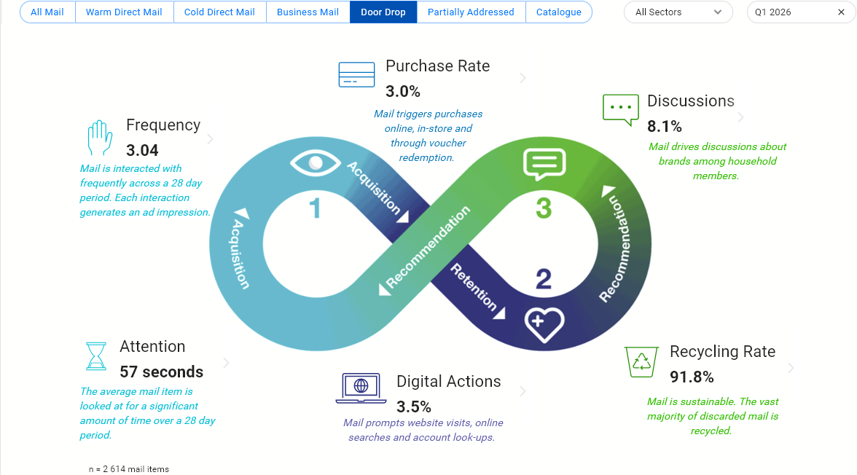
Door Drop Super Touchpoint Strengths in Q1 2026
Source: JICMAIL Item Data Q1 2026

Slide 8
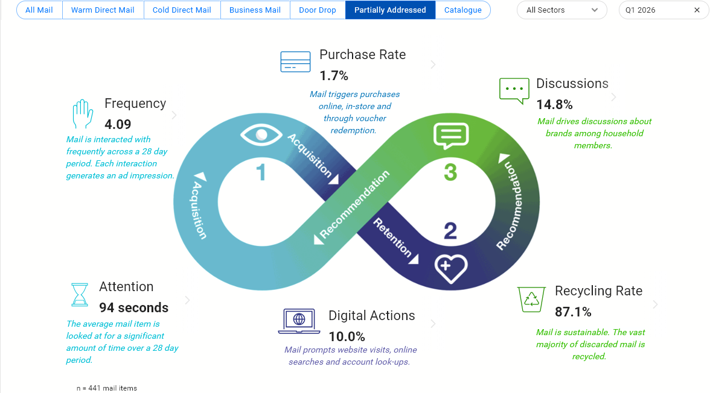
PAM’s Super Touchpoint Strengths in Q1 2026
Source: JICMAIL Item Data Q1 2026

Slide 9
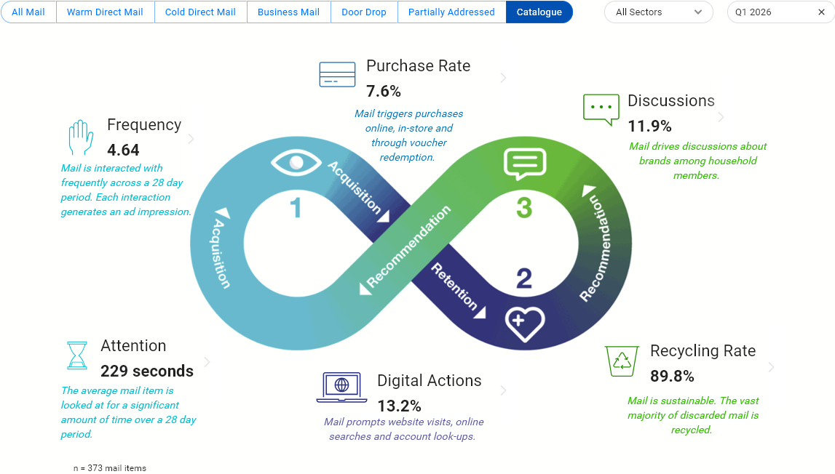
Catalogue Super Touchpoint Strengths in Q1 2026
Source: JICMAIL Item Data Q1 2026

Slide 10
Pitch
To create a Super Touchpoint planning loop for your industry sector, login to JICMAIL Discovery today.

