Slide 1
Create your own Competitor Insights in JICMAIL Discovery

Slide 2
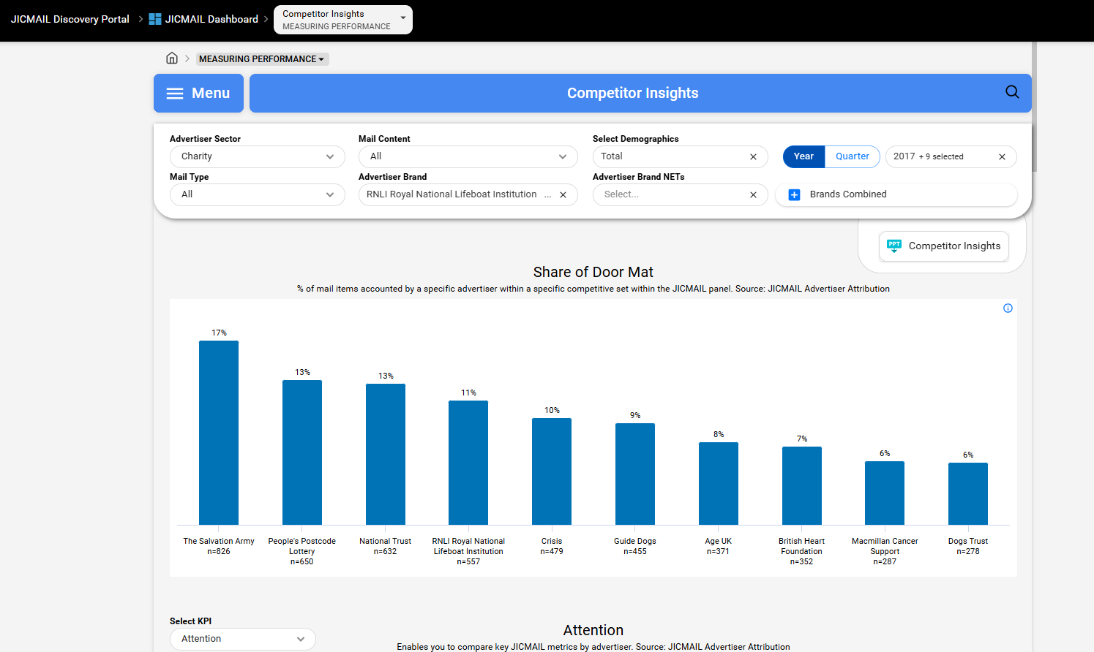
Create your own Competitor Insights in JICMAIL Discovery
Create your own Competitor Insights deck in JICMAIL Discovery
Use the filters to choose sector, mail type, time span, content and demographics
Use Advertiser Brand to include/exclude specific brands
Include in your pitch decks for the latest JICMAIL data

Slide 3
Share of Door Mat
Demographics
Timing
2022,2023,2024,2025,2026
Total
% of mail items accounted by a specific advertiser within a specific competitive set within the JICMAIL panel.
Source: JICMAIL Advertiser Attribution
British Heart Foundation | Macmillan Cancer Support | Alzheimer's Society
180 | 166 | 164

Slide 4
Frequency
Timing
Demographics
Total
2022,2023,2024,2025,2026
Enables you to compare key JICMAIL metrics by advertiser. Source: JICMAIL Advertiser Attribution
Brands with a sample of less than 30 mail items will not display in these charts.
British Heart Foundation | Macmillan Cancer Support | Alzheimer's Society
180 | 166 | 164

Slide 5
Item Reach
Timing
Demographics
Total
2022,2023,2024,2025,2026
Enables you to compare key JICMAIL metrics by advertiser. Source: JICMAIL Advertiser Attribution
Brands with a sample of less than 30 mail items will not display in these charts.
British Heart Foundation | Macmillan Cancer Support | Alzheimer's Society
180 | 166 | 164

Slide 6
Lifespan
Timing
Demographics
Total
2022,2023,2024,2025,2026
Enables you to compare key JICMAIL metrics by advertiser. Source: JICMAIL Advertiser Attribution
Brands with a sample of less than 30 mail items will not display in these charts.
British Heart Foundation | Alzheimer's Society | Macmillan Cancer Support
180 | 164 | 166

Slide 7
Attention
Timing
Demographics
Total
2022,2023,2024,2025,2026
Enables you to compare key JICMAIL metrics by advertiser. Source: JICMAIL Advertiser Attribution
Brands with a sample of less than 30 mail items will not display in these charts.
British Heart Foundation | Macmillan Cancer Support | Alzheimer's Society
180 | 166 | 164

Slide 8
Audience Profile
Timing
Demographics
Total
2022,2023,2024,2025,2026
Age categories
The demographic and/or geodemographic composition of the individuals and households
who are targeted by specific advertisers. Source: JICMAIL Advertiser Attribution
A minimum sample size of 30 is applied to these charts.
Alzheimer's Society | British Heart Foundation | Macmillan Cancer Support
164 | 180 | 166

Slide 9
Audience Profile
Timing
Demographics
Total
2022,2023,2024,2025,2026
Gender
The demographic and/or geodemographic composition of the individuals and households
who are targeted by specific advertisers. Source: JICMAIL Advertiser Attribution
A minimum sample size of 30 is applied to these charts.
Alzheimer's Society | British Heart Foundation | Macmillan Cancer Support
164 | 180 | 166

Slide 10
Audience Profile
Timing
Demographics
Total
2022,2023,2024,2025,2026
Social Grade
The demographic and/or geodemographic composition of the individuals and households
who are targeted by specific advertisers. Source: JICMAIL Advertiser Attribution
A minimum sample size of 30 is applied to these charts.
Alzheimer's Society | British Heart Foundation | Macmillan Cancer Support
164 | 180 | 166

Slide 11
Audience Profile
Timing
Demographics
Total
2022,2023,2024,2025,2026
Single or multi person household
The demographic and/or geodemographic composition of the individuals and households
who are targeted by specific advertisers. Source: JICMAIL Advertiser Attribution
A minimum sample size of 30 is applied to these charts.
Alzheimer's Society | British Heart Foundation | Macmillan Cancer Support
164 | 180 | 166

Slide 12
Audience Profile
Timing
Demographics
Total
2022,2023,2024,2025,2026
Couple
The demographic and/or geodemographic composition of the individuals and households
who are targeted by specific advertisers. Source: JICMAIL Advertiser Attribution
A minimum sample size of 30 is applied to these charts.
Alzheimer's Society | British Heart Foundation | Macmillan Cancer Support
164 | 180 | 166

Slide 13
Audience Profile
Timing
Demographics
Total
2022,2023,2024,2025,2026
Household with children
The demographic and/or geodemographic composition of the individuals and households
who are targeted by specific advertisers. Source: JICMAIL Advertiser Attribution
A minimum sample size of 30 is applied to these charts.
Alzheimer's Society | British Heart Foundation | Macmillan Cancer Support
164 | 180 | 166

Slide 14
Audience Profile
Timing
Demographics
Total
2022,2023,2024,2025,2026
Tenure length
The demographic and/or geodemographic composition of the individuals and households
who are targeted by specific advertisers. Source: JICMAIL Advertiser Attribution
A minimum sample size of 30 is applied to these charts.
Alzheimer's Society | British Heart Foundation | Macmillan Cancer Support
164 | 180 | 166

Slide 15
Audience Profile
Timing
Demographics
Total
2022,2023,2024,2025,2026
Tenure type
The demographic and/or geodemographic composition of the individuals and households
who are targeted by specific advertisers. Source: JICMAIL Advertiser Attribution
A minimum sample size of 30 is applied to these charts.
Alzheimer's Society | British Heart Foundation | Macmillan Cancer Support
164 | 180 | 166

Slide 16
Audience Profile
Timing
Demographics
Total
2022,2023,2024,2025,2026
MOSAIC UK Group
The demographic and/or geodemographic composition of the individuals and households
who are targeted by specific advertisers. Source: JICMAIL Advertiser Attribution
A minimum sample size of 30 is applied to these charts.
Alzheimer's Society | British Heart Foundation | Macmillan Cancer Support
164 | 180 | 166

Slide 17
Audience Profile
Timing
Demographics
Total
2022,2023,2024,2025,2026
ACORN Group
The demographic and/or geodemographic composition of the individuals and households
who are targeted by specific advertisers. Source: JICMAIL Advertiser Attribution
A minimum sample size of 30 is applied to these charts.
Alzheimer's Society | British Heart Foundation | Macmillan Cancer Support
164 | 180 | 166

Slide 18
Audience Profile
Timing
Demographics
Total
2022,2023,2024,2025,2026
Customer / donor
The demographic and/or geodemographic composition of the individuals and households
who are targeted by specific advertisers. Source: JICMAIL Advertiser Attribution
A minimum sample size of 30 is applied to these charts.
Empty result

Slide 19
Key Actions
Timing
Demographics
Total
2022,2023,2024,2025,2026
Physical Actions
The % of total actions taken accounted for
by different physical interactions and commercial actions. Source: JICMAIL Advertiser Attribution
Threw it away | Threw it away/recycled (NET) | Read/looked/glanced at it | Opened it | Recycled | Put it aside to look at later | Put it in the usual place | Passed it on/left out for the person it's for | Filed it for reference or records | Used/did something with the information | Put it on display (e.g.on a fridge,noticeboard) | Took it out of the house (e.g.to work)
390 | 390 | 393 | 293 | 232 | 182 | 39 | 33 | 20 | 27 | 7 | 4

Slide 20
Key Actions
Timing
Demographics
Total
2022,2023,2024,2025,2026
Commercial Actions
The % of total actions taken accounted for
by different physical interactions and commercial actions. Source: JICMAIL Advertiser Attribution
Discussed with someone | Bought something/made a payment or donation (NET) | Visited sender's website | Posted a reply to the sender | Went online for more information | Made a purchase/payment/donation online | Used a tablet or smartphone | Called the sender | Made a purchase/payment/donation in a shop | Made a purchase/payment/donation by other means (e.g. postal, phone) | Emailed the sender | Used a voucher/discount code | Planned a large purchase | Visited sender's shop/office | Looked up my account details | Used a QR code
43 | 22 | 23 | 18 | 7 | 4 | 3 | 4 | 3 | 10 | 1 | 1 | 1 | 1 | 2 | 1

