Slide 1
Introduction to
JICMAIL and TGI Fusion applications
Feb 2022

Slide 2

What we have done
Fused two data sources, JICMAIL and TGI, any variable from one database can now be analysed against any variable from the other database.
This facilitates early consideration of mail in the planning cycle.
Fusion of two data sources:
JICMAIL 2021
(fieldwork: October 2020 – September 2021)
+
TGI: UK 2021
(fieldwork: October 2020 – September 2021)
https://www.jicmail.org.uk/data/methodology/

Slide 3







For the first time Audience, Frequency and Actions data for mail can now be associated across millions of TGI data points
UNIVERSITY EDUCATED
INCOME £50K+
MAIN SHOPPER
COMPANY DIRECTOR
MOVED HOUSE IN LAST YEAR
4.54
4.33
4.55
4.82
4.54
DIRECT MAIL
3.10
3.04
3.05
2.83
3.10
DOOR DROP
Source: Kantar TGI GB 2021 + JICMAIL n= 24,409

Slide 4
Users can now access TGI’s unique variables for brand consumption, consumer targeting and interest areas to optimise mail planning!
Robust Insight
Addressed Mail, Door Drops and Business Mail audiences are now included in the TGI demographic, attitudinal and behavioural models
Improved targeting
Enhanced Targeting with new JICMAIL audiences in TGI. Uncover new segments who are most responsive to mail
Enhanced Planning
Enhance ROI and effectiveness with access to new media usage information and segmentations: finding the best combinations of channels to reach an audience
Currency Data
JICMAIL Reach and Frequency data enables impression-based planning for Ad Mail, uncovering new synergies with TV, print, online, mobile, radio, and outdoor

Slide 5

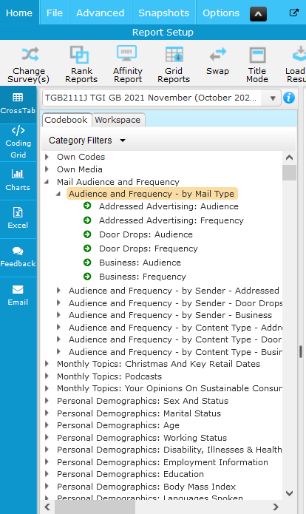

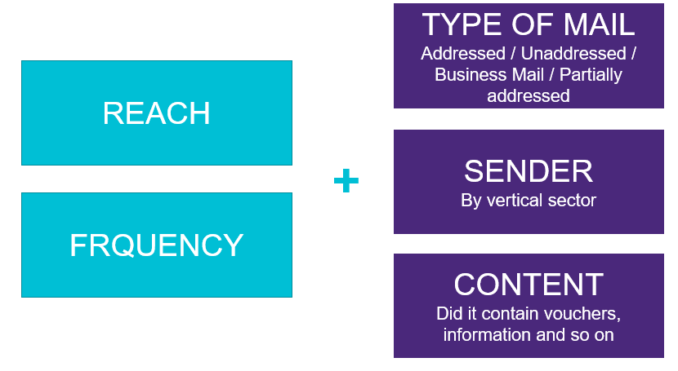
And through Telmar, Choices and IMS

Slide 6
How do key audiences
(or customers) interact with mail
Various examples follow

Slide 7
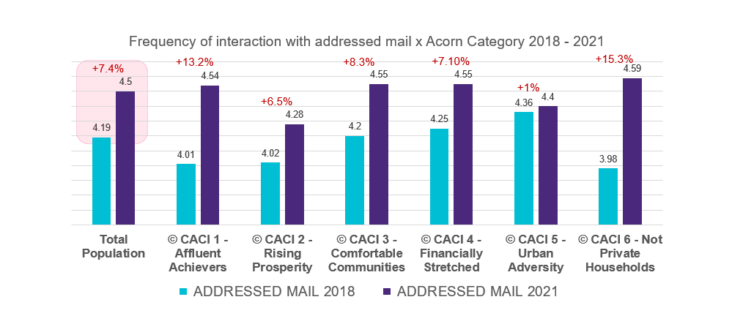
The Covid pandemic has led to significant increases in DM interaction rates across the market (Pre Covid – Post Covid)
Source: Kantar TGI GB 2018/ 2021 + JICMAIL n= 24,409
Notes:
Interaction rates with DM up 7.4% across UK population in the post covid ers

Slide 8
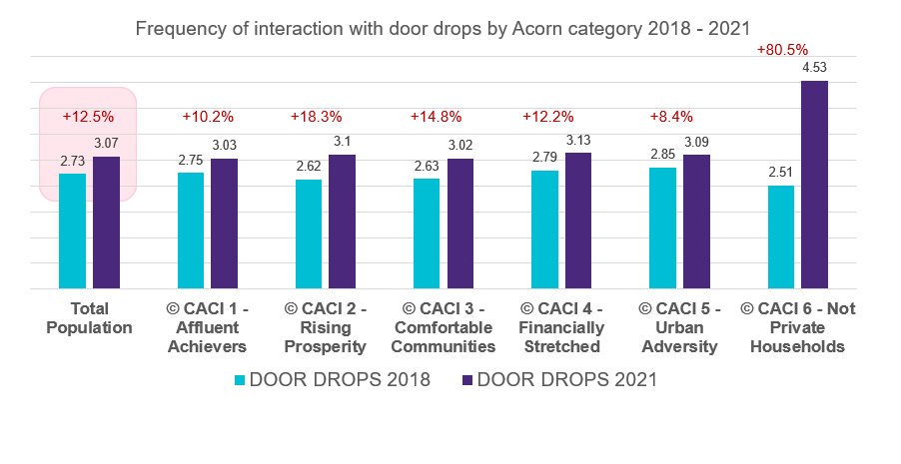
And Door Drop interaction rates are up 13% over three years (Pre Covid – Post Covid)
Source: Kantar TGI GB 2018/ 2021 + JICMAIL n= 24,409

Slide 9
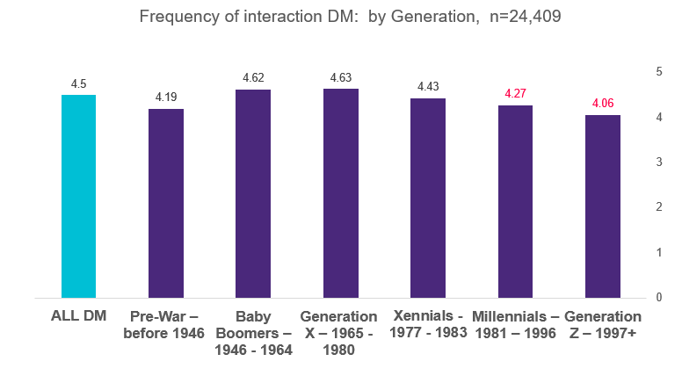
No evidence of a generation gap! Digital natives interact with mail as much as other generations
Similar interaction rates with mail! Whether Baby Boomer, Millennial or Gen Z
Source: Kantar TGI GB 2021 + JICMAIL n= 24,409
Notes:
While younger groups are being targeted more they interact WITH THE MAIL THEY RECEIVE AT VERY SIMILAR LEVELS – The irony therefore is if you want the attention of young people then send them a letter

Slide 10
JICMAIL/ TGI Fusion uncovers sector specific insights for Door Drops

Slide 11

Door Drops signal acquisition in Telco sector
Subscribed/ Switched to a new service
Index: +165
(65% more than the UK average)
13%
of the UK population has joined a new Telecoms service as a result of receiving a Door Drop
Source: Kantar TGI GB 2018/ 2021 + JICMAIL n= 24,409
Notes:
The latest TGI Fusion data indicates that 13% of the UK population has switched Telecoms services as a result of receiving a Door Drop. This is 65% more than the average for the UK population

Slide 12

Door Drops drive consideration in the car market
Intend to buy a vehicle in the next two years…
YES
Visited Sender’s website or went online as a result of a Door Drop
37%
Index: 128
(28% higher than the UK average)
Source: Kantar TGI GB 2018/ 2021 + JICMAIL n= 24,409, Index 100 = UK average
Notes:
Door drops drive car buyers online! 37% of those people who intend to buy a car in the next two years visited the senders website or went online as a result of receiving a door drop. 28% more than the average for the UK population!

Slide 13

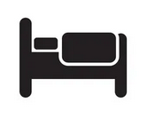
Door Drops drive Domestic Tourism ‘Hot Prospects’ on-line
I intend to holiday in the UK for some time to come
DEFINITELY AGREE
Visited Sender’s website or went online as a result of a Door Drop
31%
Index: 116
(16% more than the UK average)
Source: Kantar TGI GB 2018/ 2021 + JICMAIL n= 24,409
Notes:
31% of people in the UK who intend to go on a staycation have visited the senders website or gone online as a result of receiving a relevant door drop. 16% HIGHER than the average for the UK population.

Slide 14

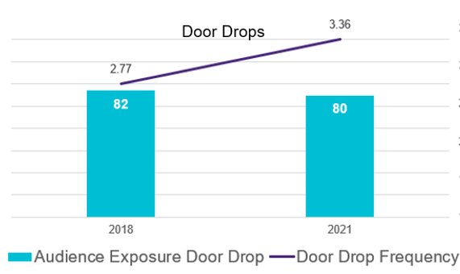
Over the Covid era interaction rates with FS Admail has increased by 21% yet viable audiences are not being targeted!
+21%
Source: Kantar TGI GB 2018/ 2021 + JICMAIL n= 24,409
Notes:
People who are interested in Financial Services Admail are not being targeted! – While interaction rates are high and have increased significantly over three years (Pre Covid – Post Covid)

Slide 15
Uncover hidden audience opportunities for mail

Slide 16
The hidden audience opportunities with mail
Audiences with high levels of interaction with mail but low exposure scores indicate a highly receptive target because they interact strongly with the little mail they receive
AUDIENCE REACH / EXPOSURE INDEX
Hidden mail opportunity
FREQUENCY OF INTERACTION

Slide 17
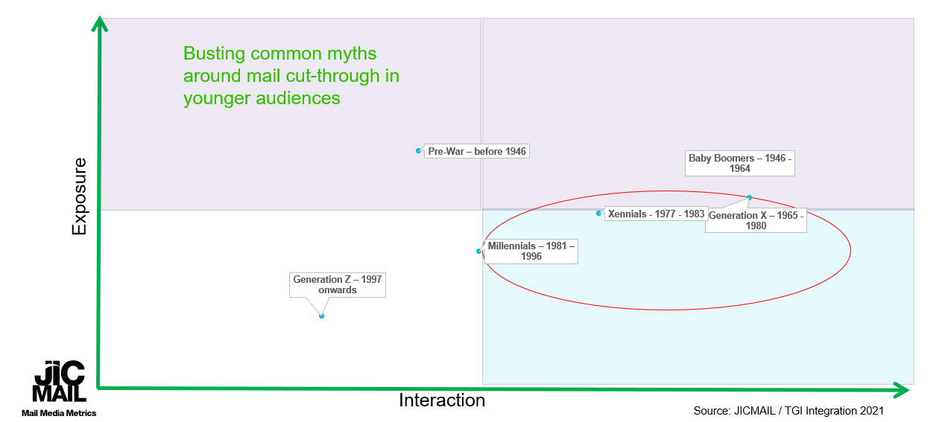
GenX, Xennials and Millenials interact highly with DM, but are not being targeted
Source: JICMAIL / TGI Integration 2021
17
Notes:
Busting common myths around mail cut-through in younger audiences

Slide 18
Those planning to purchase computers, tablets and music systems are highly receptive to door drops
Audience Exposure
Frequency of Interaction
Source: Kantar TGI GB 2018/ 2021 + JICMAIL n= 24,409

Slide 19
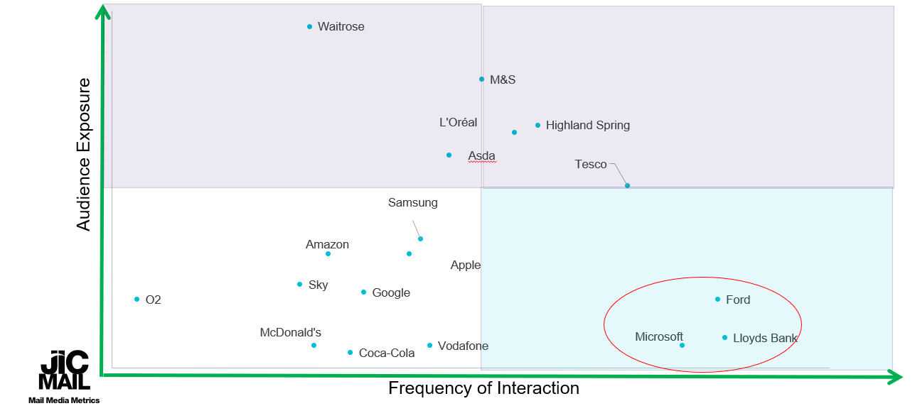
Microsoft, Lloyds and Ford consumers interact highly with door drops, but are not being targeted!
Source: Kantar TGI GB 2018/ 2021 + JICMAIL n= 24,409
19

Slide 20
Uncovering opportunities for Multi-channel planning with mail

Slide 21
Opportunities in Cross channel optimisation
Strong cross-over between TV/VOD and Door Drop audiences in the Health sector
Door Drops Index:
Target Group:
Interested in Health and Wellbeing content in electronic media
 | Door Drops Index | Frequency of Interaction
AVERAGE | 100 | 3.01
I specially choose to listen to it ~ Radio Shows-Health And Wellbeing | 117 | 3.73
Health and Wellbeing on TV - I Usually Watch | 242 | 3.24
Health/Fitness - Follow on Social media | 117 | 3.12
Lifestyle & Health on Podcasts - Yes | 166 | 3.52
Interaction rates with Door Drops are very high for people who access Health and Wellbeing content through electronic media opening new opportunities for optimisation and cut-through in multi-media planning
Source: Kantar TGI GB 2018/ 2021 + JICMAIL n= 24,409
Notes:
People who access Health and Wellbeing content through electronic media over-index very significantly on Door Drop reach and frequency

Slide 22

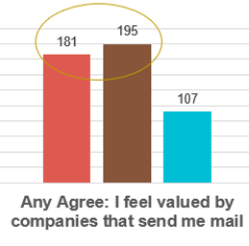
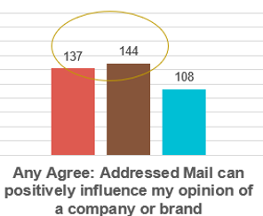
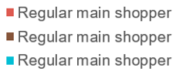
DM drives brand loyalty up to 81% more in the big four grocers versus discounters
- Any big four
- Any Tesco Metro/ Express
- Any Discounter
What does this look like for your brand?
Source: Kantar TGI GB 2018/ 2021 + JICMAIL n= 24,409
Notes:
Main shoppers at any of the big 4 grocers value direct mail and its positive influence up to 81% more than main shoppers at any discounter

Slide 23
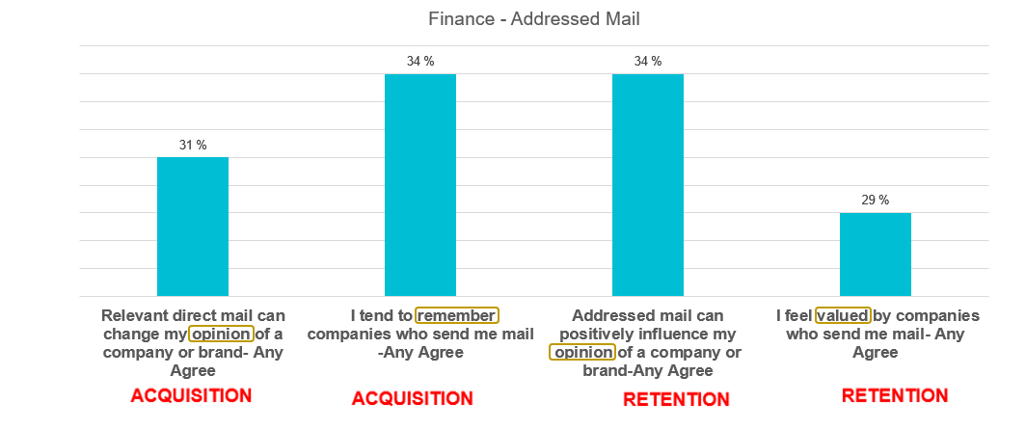
Mail strongly influences brand opinion, retention and recall in Financial Services
What role does mail play for your brand in retention and acquisition?
Source: Kantar TGI GB 2018/ 2021 + JICMAIL n= 24,409

Slide 24
We look forward to discussing JICMAIL applications for your business

Slide 25
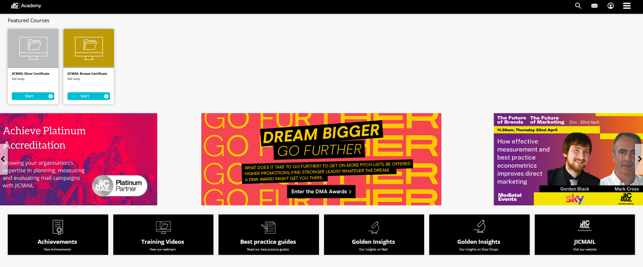
JICMAIL: Sign-up, Training and Certification
CPD credits (IPA)
Contact
jicmail.org.uk
linkedin.com/company/jicmail
tara@jicmail.org.uk
@jicmailuk

