Slide 1
JICMAIL
Customer Engagement Survey Results
July 2020

Slide 2
Three key takeaways
1) A highly familiar user base
2) Driving revenue with JICMAIL
3) Boosting industry credibility
98% are familiar with JICMAIL. 84% have accessed it in the last six months
78% have used JICMAIL to pitch for new business or budget.
94% believe JICMAIL underpins the credibility of the ad mail industry

Slide 3
The JICMAIL Customer Survey: Measuring the impact of JICMAIL throughout the planning cycle
INPUTS: Is the market familiar with JICMAIL and is JICMAIL data being used?
OUTPUTS: Does the market understand what JICMAIL has to offer?
OUTTAKES: Do users have a positive experience working with JICMAIL and will they recommend it to others?
OUTCOMES: How has JICMAIL positively impacted businesses and the market as a whole?

Slide 4
Response evenly balanced between the buy and sell side
*majority of “other” responses were from sell-side organisations
Source: JICMAIL Customer Survey July 2020, n=57

Slide 5
INPUTS: The market is highly familiar with JICMAIL
84%
have accessed JICMAIL
data in the past six months
Source: JICMAIL Customer Survey July 2020, n=57

Slide 6
OUTPUTS: Strong understanding about what JICMAIL offers the market. Good awareness of data integrations.
Source: JICMAIL Customer Survey July 2020, n=57

Slide 7
OUTTAKES: Overwhelmingly positive customer service scores for JICMAIL
Source: JICMAIL Customer Survey July 2020, n=57

Slide 8
OUTTAKES: Positive customer experience driven by ease of data access, communication and training and support
Source: JICMAIL Customer Survey July 2020, n=57

Slide 9
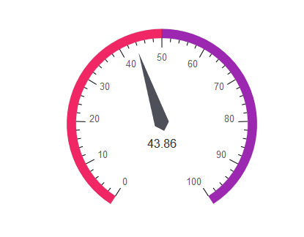
OUTTAKES: Very positive Net Promoter Score for JICMAIL
How likely are you to recommend JICMAIL to clients or colleagues?
Detractors (0-6) | 5%
Passives (7-8) | 46%
Promoters (9-10) | 49%
Source: JICMAIL Customer Survey July 2020, n=57; NPS = % promoters minus % detractors

Slide 10
OUTTAKES: Why people are likely to recommend JICMAIL
“
It is a brilliant tool and set of metrics to support the mail channel.
“
“
It is a powerful tool to prove the effectiveness of mail driving commercial actions
Most extensive insight for mail beyond direct response available.
“
“
It is so credible. It is completely independent.
“
For agencies in particular, JICMail helps puts mail and door drop on the agenda with their client, as well as helping clients to consider the channel differently.
Takes the guesswork out of DM and drives home what an important part of the mix it is.
“
Because it puts Mail on an equal footing to other media when being planned or measured.

Slide 11
OUTCOMES: Mail interaction, impact and halo effect are particularly useful for the market. 78% have used it to pitch for new business or budget
Source: JICMAIL Customer Survey July 2020, n=57

Slide 12
OUTCOMES: JICMAIL underpins the credibility of the industry and usage is only going to increase, with 86% expecting to use it more in the future
Source: JICMAIL Customer Survey July 2020, n=57

Slide 13
Three key takeaways
1) A highly familiar user base
2) Driving revenue with JICMAIL
3) Boosting industry credibility
98% are familiar with JICMAIL. 84% have accessed it in the last six months
78% have used JICMAIL to pitch for new business or budget.
94% believe JICMAIL underpins the credibility of the ad mail industry

Slide 14
Thanks from JICMAIL
jicmail.org.uk
linkedin.com/company/jicmail
ian@jicmail.org.uk
@jicmailuk

