Slide 1
CHRISTMAS 2019 REVIEW - HIGHLIGHTS
FOR RETAIL / ONLINE RETAIL ADVERTISING MAIL
A review of direct mail and door drop performance for key retailers and online retailers using JICMAIL, the industry’s planning currency data
For further analysis or queries email tara@jicmail.org.uk

Slide 2
Christmas 2019 Review – Five key learnings
Christmas is a time for sharing! Over the 2019 festive period 1.14 people per household interacted with the average retail DM piece and 1.06 people with Door Drop. Mail reaches more than just the person it’s addressed to, and more than just one person in the household it’s targeted at.
Both Direct Mail and Door Drops average lifespans are up on their 2018 figures (averaging at 8.6 and 6 days respectively). Mail has staying power during a season when there is more ad clutter and media noise than at any other time of year.
Variations in lifespans by brand for mail across this key trading season were notable, with Marks & Spencer (over 12 days on average) and Boots (over 11 days) standing out as top performers.
The average retail DM piece was interacted with 4.2 times per item and for Door Drops the figure was 2.8. These interactions / exposures prompt positive commercial outcomes: DM initiated positive effects throughout the purchase funnel with 12% prompting word of mouth brand discussions and 16% driving online actions (effects often attributed to other channels). A further 8% of items drove a purchase and 9% a voucher redemption. 4% of Door Drops in the retail sector resulted in either a purchase or the use of a voucher/ discount code while 8% drove upper funnel discovery actions such as planning a large purchase, brand discussions and online browsing.
Complementing its longer than average lifespans, Marks & Spencer mail enjoyed the highest exposure rates with 4.84 interactions per item, closely followed by Cotton Traders and Studio as top performing brands.

Slide 3
Christmas 2019 Review – Explore your brand’s performance
The JICMAIL dataset contains 145,100 mail journeys with reliable sample sizes for the top 150 UK brands across nine key industry categories.
Data is updated quarterly, six weeks after the end of each quarter.
While normal patterns of Christmas mail were disrupted by the December 2019 general election with political parties comprising 4 of the top 10 senders of admail, the depth of JICMAIL’s data still allows us to explore mail performance at the retail category and brand level.
Share of Mail Voice: the retail sector is highly fragmented with the top brand accounting for only 3.3% share of mail voice. The top 25 brands account for only 33% of the total. Use JICMAIL data to explore where your brand fits into the retail mail landscape and generate data driven recommendations on how to boost campaign performance during this key trading period.

Slide 4
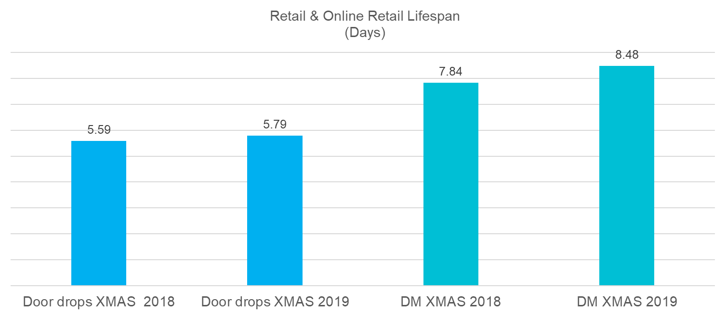
Over the 2019 Christmas season, Retail / Online Retail Door Drops were live in the home for almost 6 days while Direct Mail was live in the home for 8.5 days on average
Source: Kantar TNS ITEM DATA Q22017 – Q42019 n= 133627 all items, Mail items database 69600 items, Retail n=16199, Online Retail=10557, Retail and Online Retail and Xmas 2019=2961, Xmas 2019 DM=2198, Xmas 2019 Door Drops=530

Slide 5
2019 DM interaction rates increased YoY exceeding 4 interactions per item
Source: Kantar TNS ITEM DATA Q22017 – Q42019 n= 133627 all items, Mail items database 69600 items, Retail n=16199, Online Retail=10557, Retail and Online Retail and Xmas 2019=2961, Xmas 2019 DM=2198, Xmas 2019 Door Drops=530
Notes:
Over Christmas 2019 DM interaction rates exceeded 4 interactions per mail item on average (4.20) Year on Year variations are marginal

Slide 6
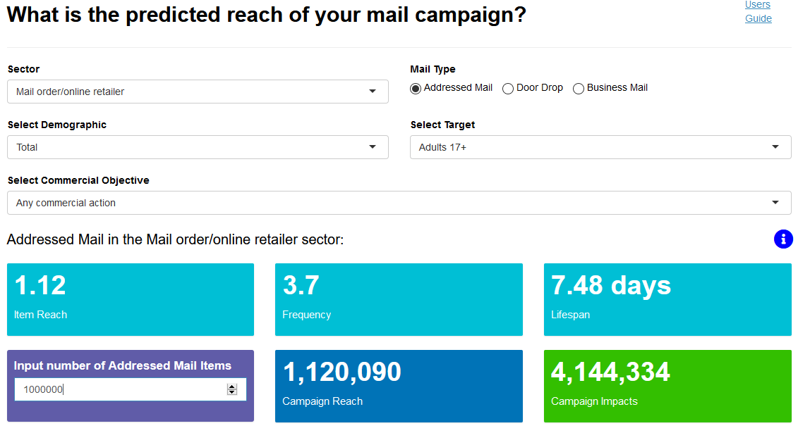
With JICMAIL reach and frequency metrics, mail can now be planned and measured on the same basis as other major channels
The extract alongside from the Mail Campaign Calculator (available on the Discovery portal) shows a circulation 1 million DM items targeting all adults delivers nearly 4.2 million campaign impacts!
Notes:
WHAT DOES THIS TELL US THAT’S NEW?
Converting circulation (items) to campaign impacts yields new metrics for mail. In online retail 1million mail items delivers 4.14 million audience (campaign) impacts!

Slide 7
12% of DM initiated word of mouth, plus other ‘upper funnel’ actions, 8% drove a purchase, 9% a voucher redemption and 3% a shop visit!
(Combined gross on-line actions 16% Amber)
Notes:
12% of DM initiated word of mouth and 16% drove online actions. A further 8% of items drove a purchase, 9% a voucher redemption and 3% a shop visit

Slide 8
DM drives effects throughout the AIDA purchase funnel
DM Past 24 Months
Awareness
Interest
Desire
Action
Notes:
AIDA purchase funnel – Upper funnel brand building and discovery behaviours can now be more accurately attributed, rather than last click attribution

Slide 9
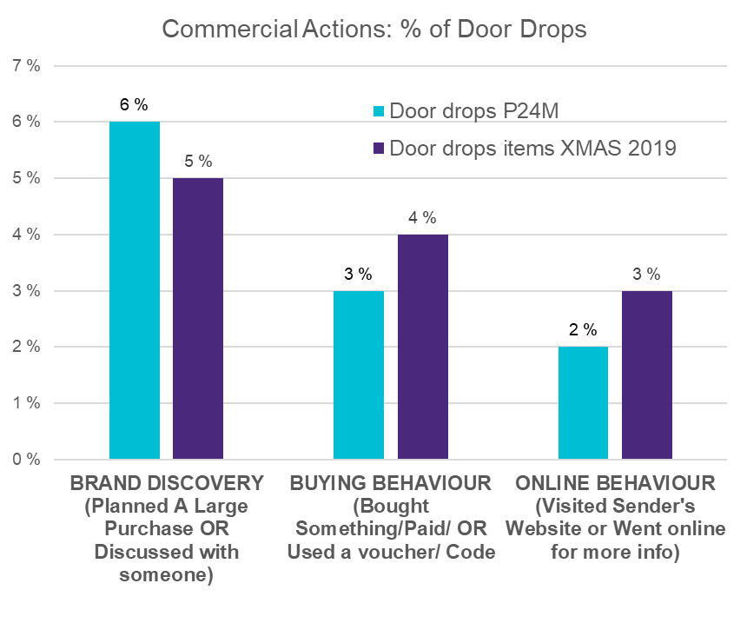
Despite an intense Christmas media marketplace, 5% of door drops initiated brand conversations/planning, 3% online browsing and 4% buying behaviours
Commercial Actions % of Door Drops
Christmas 2019 vs Past 24 Months (P24M)
(Amber arrows highlight key journey behaviours )
Notes:
Upper funnel consumer behaviours are stimulated by door drops in the retail sector

Slide 10
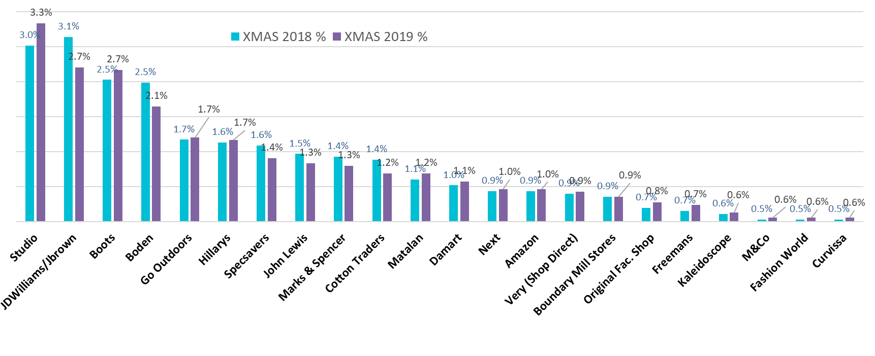
The retail / online retail sector is highly fragmented with the top brand accounting for only 3.3% share of mail voice and the top 25 brands accounting for 33% of the total.
Share of Mail Voice
Source: Kantar TNS ITEM DATA Q22017 – Q42019 n= 133627 all items, Mail items database 69600 items, Studio 394, JDWilliams 384, Boots 323,Boden 299, Go Outdoors 214, Hillarys 202, Specsavers 199, John Lewis 195, Marks & Spencer 171, Cotton Traders 165, Matalan 147, Damart 135, Next 133, Amazon 124, Very (Shop Direct) 121, Boundary Mill Stores 105, Original Fac. Shop 93, Freemans 84, Kaleidoscope 80, M&Co 70

Slide 11
Thank you
jicmail.org.uk
linkedin.com/company/jicmail
tara@jicmail.org.uk
@jicmailuk

