Slide 1
JICMAIL Panel
How JICMAIL data is collected

Slide 2





JICMAIL Board and data governance
SELL SIDE
BUY SIDE
JICMAIL is an independent, not-for-profit data and research organisation
Owned jointly by the both buy-side and sell-side industry
Providing insight into consumer actions with mail in the home

Slide 3

Who is responsible for running the JICMAIL panel?
Kantar, the global data and insights company, operate the JICMAIL panel.
They have over 30,000 employees around the world and conduct brand and marketing communications research for 92 of the world's largest 100 advertisers www.kantar.com
Kantar are part of the Media Research Society and have to abide by their professional code of conduct https://www.mrs.org.uk/standards/code-of-conduct

Slide 4
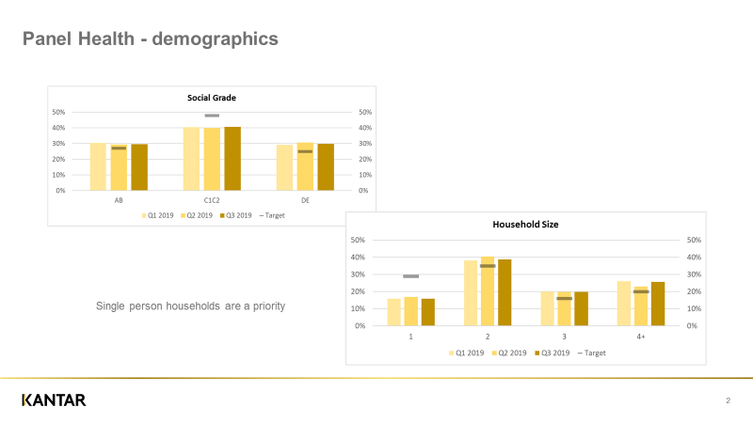
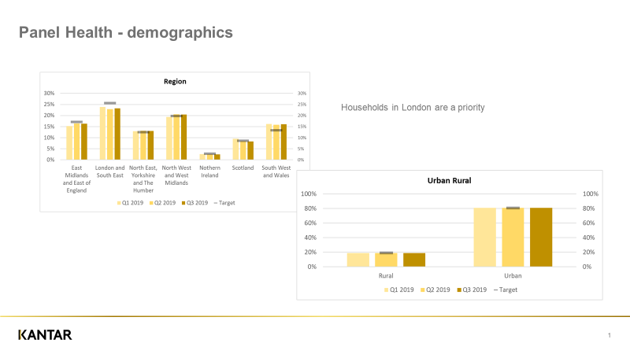
Panel demographics
The panel consists of approx. 1,000 households
Is nationally representative across household size, region and social grade according to profiles established by the National Readership Survey - a gold standard in media measurement

Slide 5
How are the panel recruited? Do they perform research for any other media?
Kantar have access to hundreds of thousands of research panellists
Kantar specifically recruit to be nationally representative across household size, region and social grade according to profiles established by the National Readership Survey
Anyone can ask to join the panel - Kantar decide whether or not they can actually take part based on whether or not we actually need someone from that demographic group
They may well take part in other media research - Kantar don’t exclude anyone on that basis

Slide 6

How are the panellists remunerated?
The panel receive points that they trade in for vouchers
They are also entered in to monthly prize draws
They do not receive an incentive for recording mail activity (to avoid biasing the data)
.

Slide 7
Do panellists record actions because they are on a research panel? Can we trust the data is accurate?
JICMAIL methodology was piloted for two years
Kantar regularly communicate with panel to ensure they understand their responsibilities
A series of checks and balances are in place to check panel consistency
JICMAIL operate a Technical Committee, chaired by a research expert, who monitor the data for accuracy

Slide 8
Q&A
We welcome questions with regards to the data or the panel. Just get in touch with us at tara@jicmail.org.uk

Slide 9
Thank you
jicmail.org.uk
linkedin.com/company/jicmail
tara@jicmail.org.uk
@jicmailuk

