Slide 1
JICMAIL TOUCHPOINTS INTEGRATION 2019

Slide 2
What is IPA TouchPoints?
Specified by the requirements of the industry, on a Joint industry basis for IPA Member Agencies and Media Owners
Trusted accountable data with a complete transparency of methodology
Only incorporating the highest quality of industry data to allow confident decisions to be made
Constantly reviewed in relation to the interests of subscribers and their clients
The only industry available cross-media channel planner
#IPATouchPoints

Slide 3
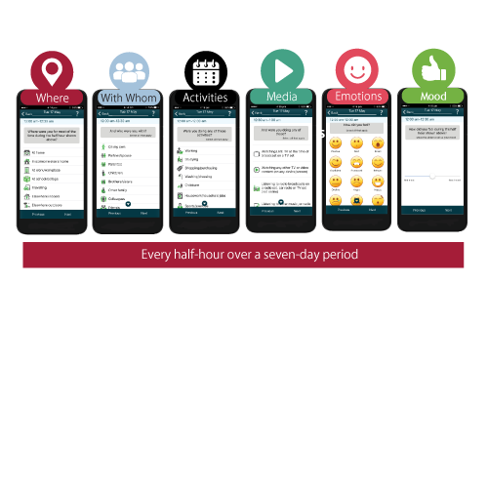
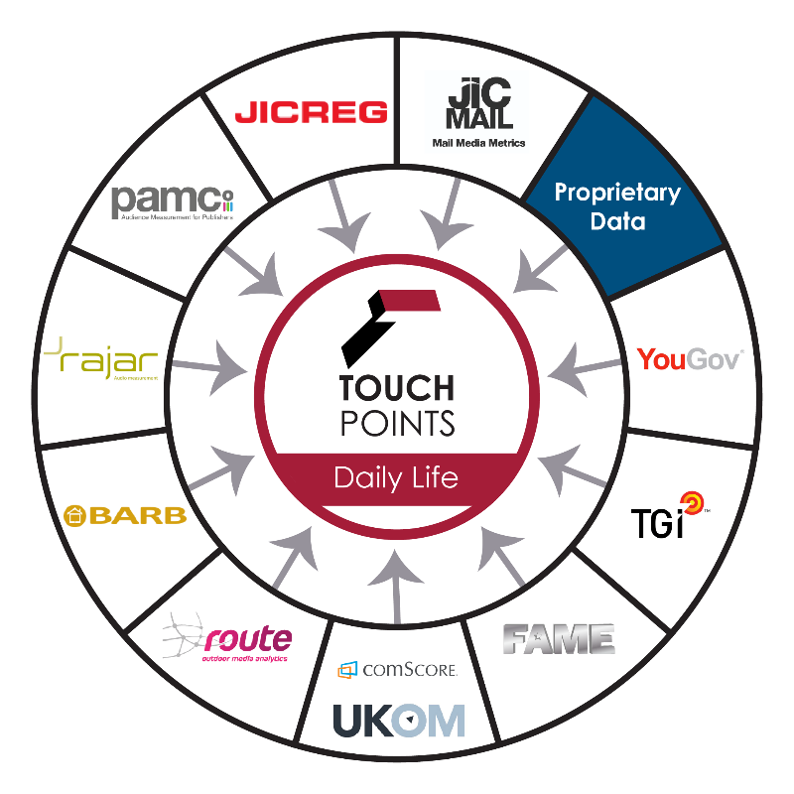
Integrating multiple JIC sources
The only industry-available cross-media channel planner
Nationally Representative
GB Sample,
6,000 adults 15+
#IPATouchPoints

Slide 4
Who use IPA TouchPoints?
Agencies
AKA | The Gate | Mindshare | Starcom
All Response Media | Havas | Miroma | Target Media
AMS | Hearts & Science | MullenLowe | The Specialist Works
Arena Media | Hunterlodge | OMD | The7Stars
Carat London | Initiative Media | PHD London | Total Media
Carat Manchester | JAA | PHD North | UM
Carat Edinburgh | Kinetic | Posterscope | VCCP Media
CHI & Partners | m/six | Publicis Media | Vizeum
December 19 | Mediacom London | Republic of Media | Wavemaker London
Essence | Mediacom North | RP2 Ltd | Wavemaker MCR
Golley Slater | MGOMD | Saatchi & Saatchi | Zenith Media
Goodstuff | Mike Colling & Co | Spark Foundry
#IPATouchPoints

Slide 5
JICMAIL is now part of the IPA TouchPoints ecosystem

Slide 6
Frequency builds in comparison to other media to identify effective exposure levels

Slide 7
Frequency builds across multiple target audiences

Slide 8
Actual reach exceeds targeted reach because mail is shared in the home
INPUT=
% AUDIENCE TARGETED
or
MAILING VOLUME

Slide 9
Mail’s natural frequency cap enables reach to be maximised: 400 to 450 GRPs: All Adults

Slide 10
Two thirds of the additional DM volumes happen at a frequency level of 2+ to 5+, avoiding over-exposure: All Adults

Slide 11
Mail’s natural frequency cap enables reach to maximised: 400 to 450 GRPs: Light TV Viewers (watch live TV once a month)

Slide 12
Schedule details: 2 print ads in Daily Mirror, 2 in Daily Mail 10 mill digital impression, 4.8 mill female targeted, 200 TVRs ALL commercial TV. DM targeting 10% of the population, Door Drops targeting 15% of the population
Mail delivers reach and frequency to multi-channel campaigns
TV, DIGITAL, PRINT
TV, DIGITAL, PRINT, DM
TV, DIGITAL, PRINT, DM, DOOR DROPS
20 million
20.8 million
+4%
21.3 million
+6%
76% reach
79% reach
+4%
81% reach
+7%
251 GRPs
292 GRPs
+16%
316 GRPs
+26%
Av Freq 3.32
Av Freq 3.72
+12%
Av Freq 3.92
+18%

Slide 13
Available to JICMAIL and IPA TouchPoints subscribers
To find out more contact
ian@jicmail.org.uk
Copyright JICMAIL

