Slide 1


Slide 2
Mail and door drop drive commercial actions
Over and above reach and frequency mail of all types is driving commercial behaviour
January 2018

Slide 3
Commercial interaction with mail
In our main reach and frequency findings we ask people to record actual physical interaction with mail. This is very specific: “did you read it, put it aside to read later or pass on to someone else?” These are all clear physical actions.
Where there is not necessarily a direct link to someone having the mailing pack or door drop in their hand at the time we do not accept this as a proxy for frequency so things like “going online” does not mean as a direct result of having the mailing or door drop in your presence so we don’t count it in our reach and frequency metrics. We call these “commercial actions”.
In order to capture the complete journey for mail the panelists are asked to go on and record what commercial activity resulted from them receiving their mail, such as “going online”, “going in-store” or “phoning the sender” and so on.
Because the commercial actions are not taken as a proxy for reach and frequency we have provided this report to give planners and those using mail greater insight into how mail triggers ongoing commercial activity.
We also give further insight into commercial actions with business mail which is not included as a mail category in the reach and frequency findings.
For further definitions of what is included in the currency for mail please see slide 18.

Slide 4
Defining commercial actions
Commercial actions:
Ordered a catalogue
Panelists record all of the actions that might be prompted by receiving the mailing or door drop.
But they may not have the mail pack with them if they go in-store and so it is not counted within JIC MAIL’s frequency metrics.
An action relating to mail which is not directly attributable to having the mailing pack or door drop in the home.
Visited a sender’s shop / office
Planned a large purchase
Called the sender
Used a tablet or smartphone
Looked up my account details
Bought something/made a payment or donation
Went online for more information
Used a voucher/discount code
Visited sender’s website
Discussed with someone

Slide 5
Commercial actions
21% of all mail items prompt a commercial action
Source: JICMAIL Q2&Q3, Kantar TNS, 2017

Slide 6
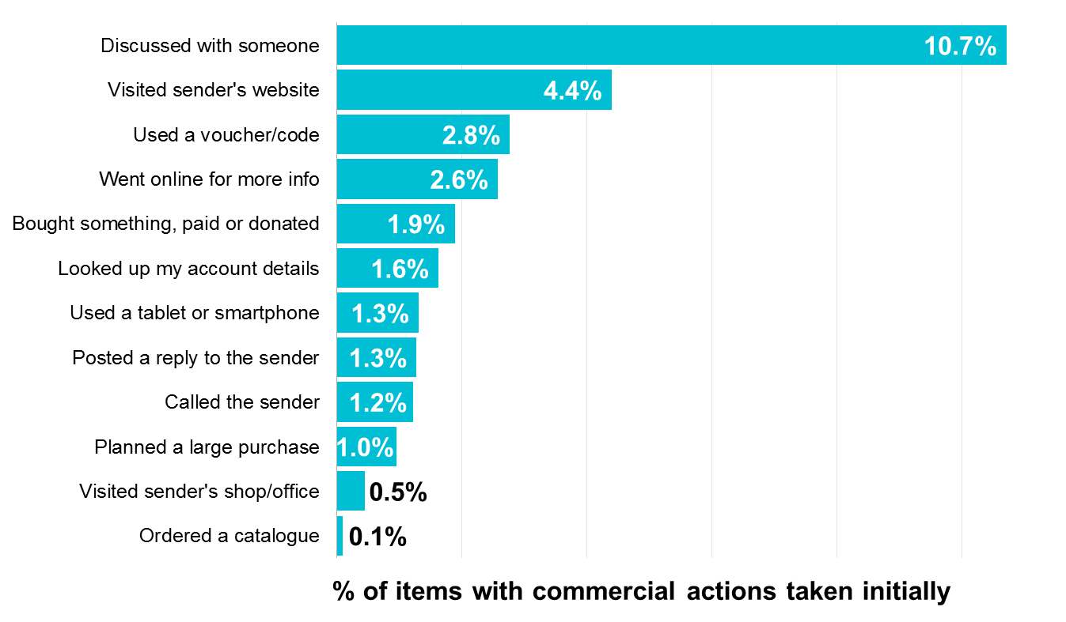
Initial commercial actions with mail
Addressed mail commercial actions taken immediately
Of the 21% of addressed mail that prompts a commercial action 10.7% of people discuss the mailing piece with someone else in the household or out of home.
Source: JICMAIL Q2&Q3, Kantar TNS, 2017
Base: Addressed Advertising Mail Items n=8,553

Slide 7
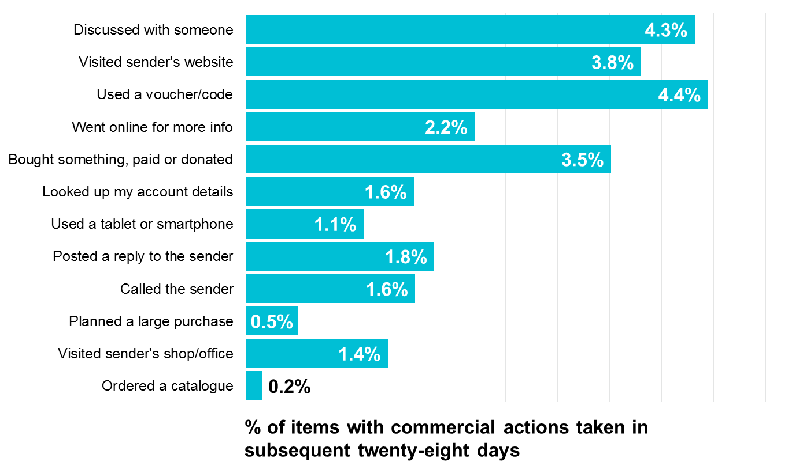
Subsequent commercial actions with mail
Addressed mail commercial actions taken over twenty-eight days
After initial actions are recorded 4.4% of items prompt the use of a voucher or code, 4.3% are discussed with another person and 3.8% visit a sender’s web site.
Source: JICMAIL Q2&Q3, Kantar TNS, 2017
Base: Addressed Advertising Mail Items n=8,553

Slide 8
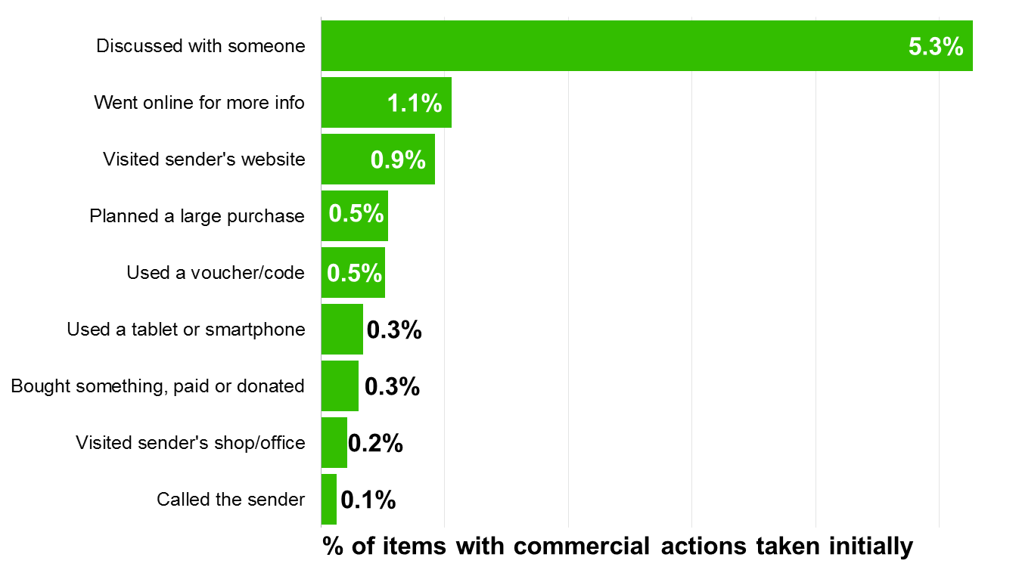
Initial commercial actions with door drop
Door drop commercial actions taken immediately
5.3% of door drops prompt discussion with another person in the household or out of home if commercial activity is taken.
Source: JICMAIL Q2&Q3, Kantar TNS, 2017
Base: Door Drop Items n=4,563

Slide 9
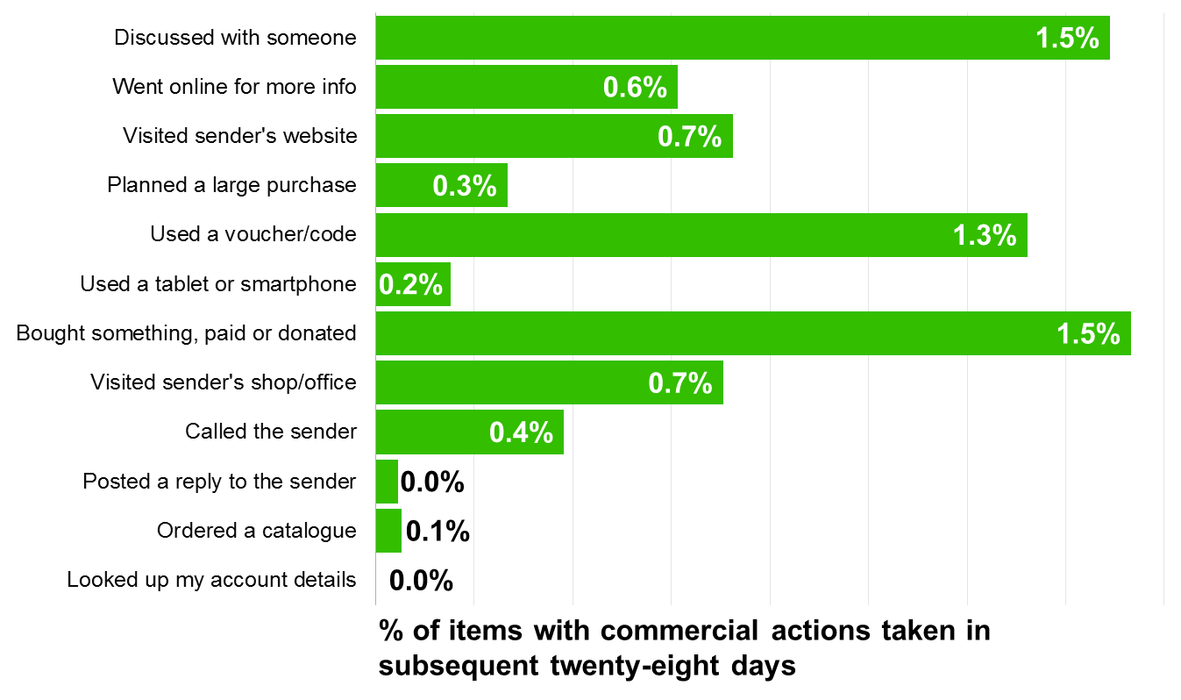
Subsequent commercial actions with door drop
Door drop commercial actions taken over twenty-eight days
There’s a broad range of commercial actions taken in over the full 28 day period topped by discussion with another person, buying something or donating and going to a sender’s web site.
Source: JICMAIL Q2&Q3, Kantar TNS, 2017
Base: Door Drop Items n=4,563

Slide 10
A special focus on business mail

Slide 11
Business mail
Business mail comprises non-advertising mail or door drop items.
These will communications like bills, statements, reminders and notifications.
We still collect business mail data to ensure we can understand the consumers entire mail box and interactions with it.
This could be useful if you are working within customer relationship marketing programmes and would like indicative data of how things like statements work.

Slide 12
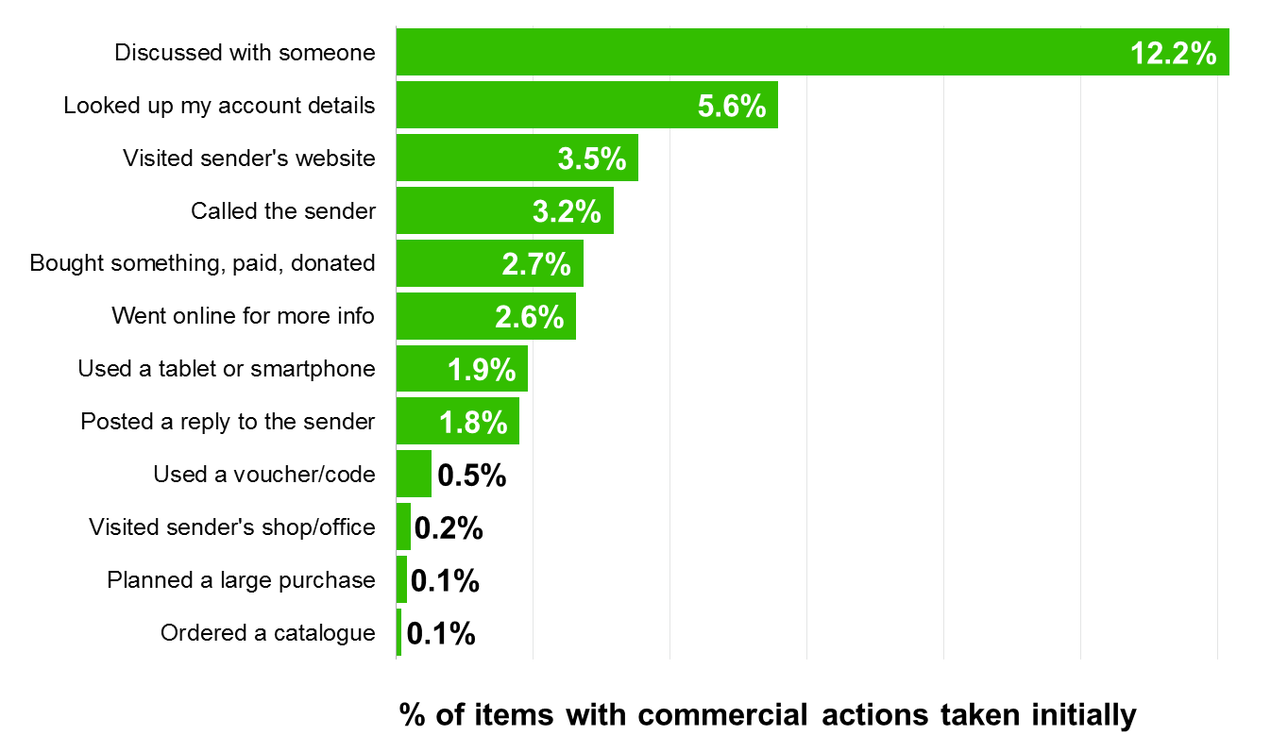
Initial commercial actions with business mail
Business mail commercial actions taken immediately
12.2% of business mail items are discussed with someone else initially.
Also notable are the 5.6% of items which prompt people to look up their account details.
Source: JICMAIL Q2&Q3, Kantar TNS, 2017
Base: Business Mail Items n=6,444

Slide 13
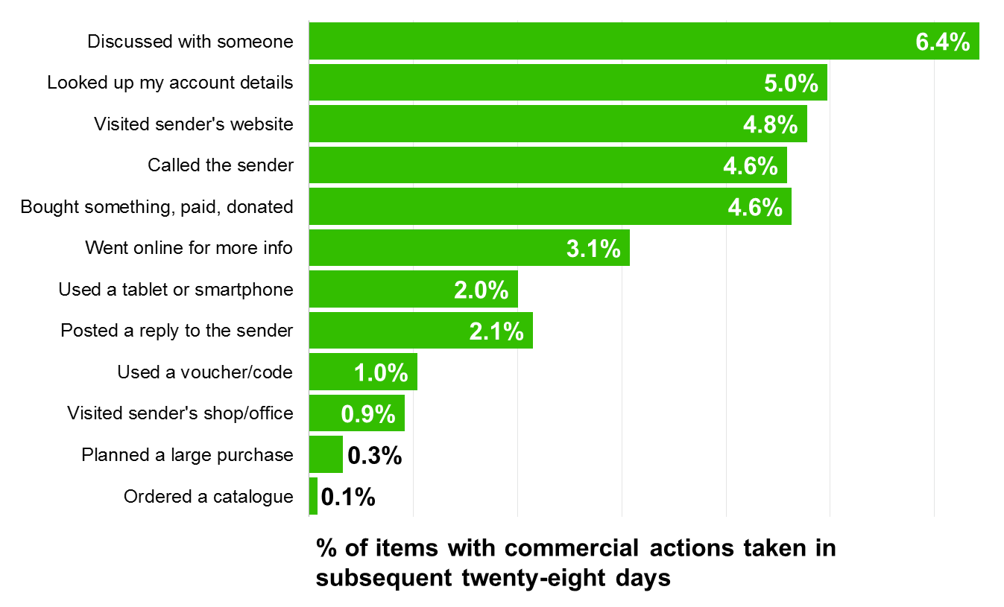
Subsequent commercial actions with business mail
Business mail commercial actions taken over twenty-eight days
Again discussion is high on the agenda in follow-up actions but so too are, looking up account details, going online, calling the sender and making some sort of purchase.
Source: JICMAIL Q2&Q3, Kantar TNS, 2017
Base: Business Mail Items n=6,444

Slide 14
The physical actions taken with mail in addition to commercial actions
These are the actions which are included in reach and frequency figures

Slide 15
Defining physical actions
Physical actions:
Took it out of the house
Panelists record all of the physical actions that might be prompted by receiving the mailing or door drop.
Actions taken with mail or door drop which are directly attributable to the addressed mail or door drop item
Put it on display
Used or did something with the information
Filed it
Passed it on to the recipient
Put it aside to look at later
Threw it away/recycled
Read/looked/glanced at it
Opened it

Slide 16
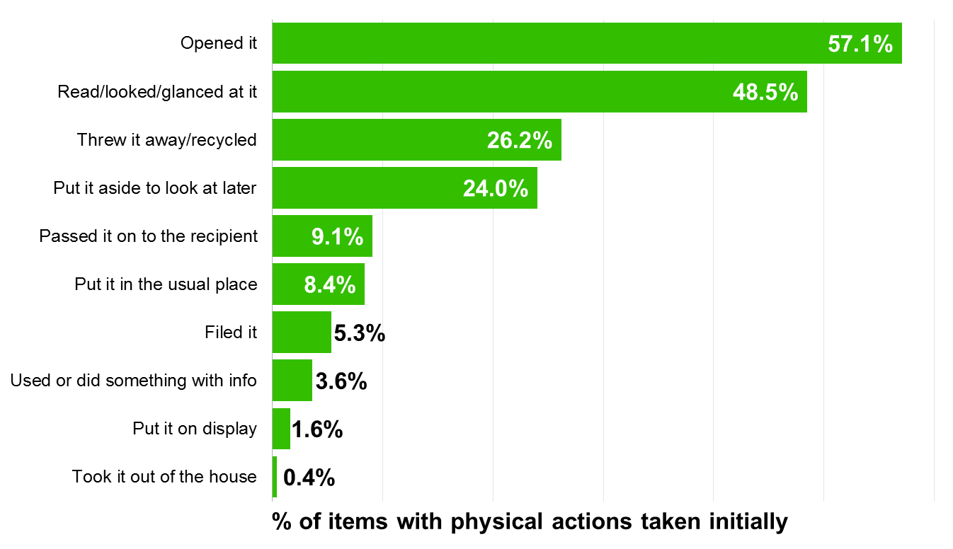
Physical actions with mail
These are the initial physical actions immediately taken with addressed mail
57.1% of mail received is initially dealt with by opening it or reading, looking or glancing at it.
Source: JICMAIL Q2&Q3, Kantar TNS, 2017
Base: Addressed Advertising Mail Items n=8,553

Slide 17
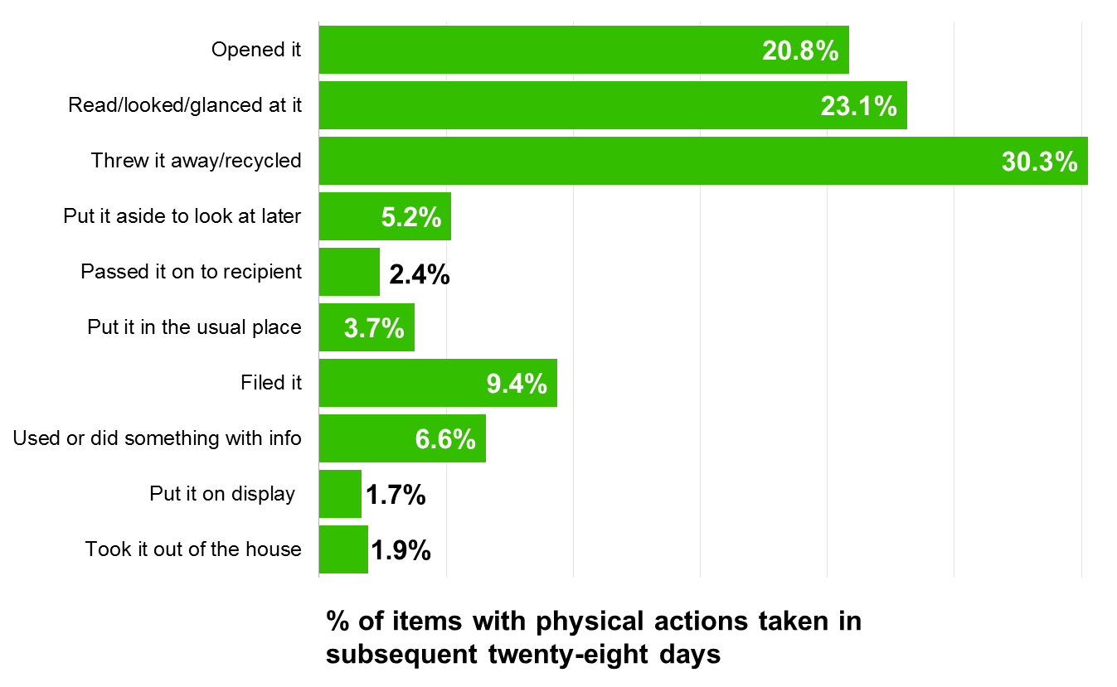
Physical actions with mail
These are the subsequent physical actions taken with addressed mail over the next twenty-eight days
In the next 28 days another 20% of mail is opened and a further 23% of it is read, looked at or glanced at.
Source: JICMAIL Q2&Q3, Kantar TNS, 2017
Base: Addressed Advertising Mail Items n=8,553

Slide 18
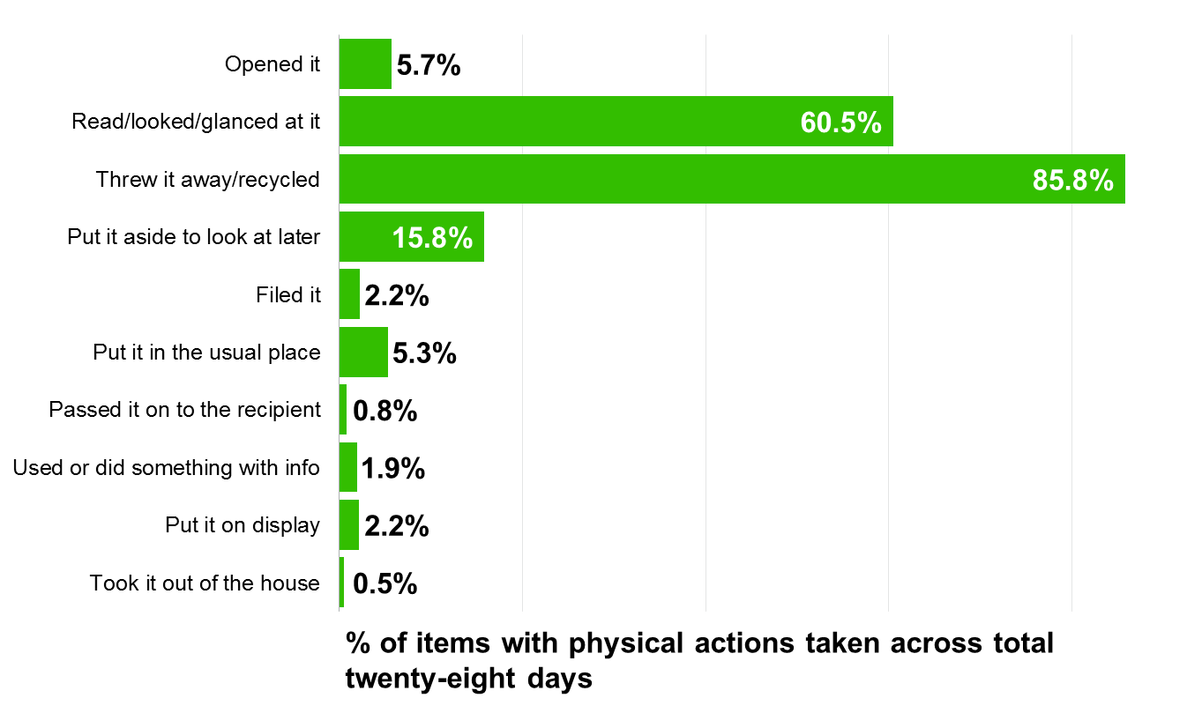
Physical actions with door drop
Over a 28 day period 60.5% of all door drops are viewed and then either recycled.
Throwing it away or recycling it counts as a single impact as the recipient has looked at it to make that decision to do this.
15.8% of items are kept to look at later or put in the usual place.
It is worth noting that open rates are lower as typically a door drop is a leaflet or postcard and won’t need opening.
These are the total physical actions taken with door drop over the full twenty-eight days
Source: JICMAIL Q2&Q3, Kantar TNS, 2017
Base: Door Drop Items n=4,563

Slide 19

JICMAIL
70 Margaret Street London W1W 8SS
www.JICMAIL.org.uk
Copyright JICMAIL

Slide 20
Mail categories gathered
and what is reported
1. Addressed mail
3. Business mail
This can effectively come from any sector that we capture, from a supermarket to a financial and services business.
It is classified as addressed mail if it clearly contains information about products and services, an offer or drive to web.
Business mail can come from any sector but must contain a financial statement, bill, notification or reminder, rather than a selling message. We have gathered this data to understand the overall mail bag but also to help planners engaged in these types of communications.
2. Door drop
4. Commercial actions
These are items which do not have an address and are not addressed to a “householder” or “occupant”. Again, of course, they will come from any sector and can be from any sender.
There is also a raft of commercial activity we collect which cannot directly be linked to someone being exposed to the mail piece. We capture this in order to give a complete picture of the impact of mail over time.
Provide key metrics for JICMail currency data
Not included in core currency – provided for extra insight

Slide 21
Defining reach and frequency
Reach
Item reach refers to the number of people in a household who have been exposed to a mail item. When a mail item has been delivered, it is automatically assigned a reach of one on the assumption that the household co-ordinator will be exposed to that item through the act of sorting through the mail.
The number of times a mail item has been interacted with based on the following list of interactions:
Frequency can be added over the entire twenty-eight day period that an item is considered ”live” within the home.
Frequency
Opened it | Threw it away/recycled
Read / looked at / glanced at it | Took it out of the house e.g. to work
Put it on display e.g. fridge / noticeboard | Used / did something with the information
Passed it on / left out for the person it’s for | Put it in the usual place
Put it aside to look at later

