Slide 2
Please note: the timeline in this presentation has clickable functionality to allow users to see significant achievements in the last three years of JICMAIL. For the best results:
Please display the presentation in SLIDE SHOW
From SLIDE 8, move forward through the different periods using the forward button in the top right hand corner
On the timeline, click the JICMAIL logo to see the achievement
Click again to see the relevant insight
Use the back button in the top right hand of the slide to return to the timeline
For more information about any of the data we have shared, please contact tara@jicmail.org.uk

Slide 25
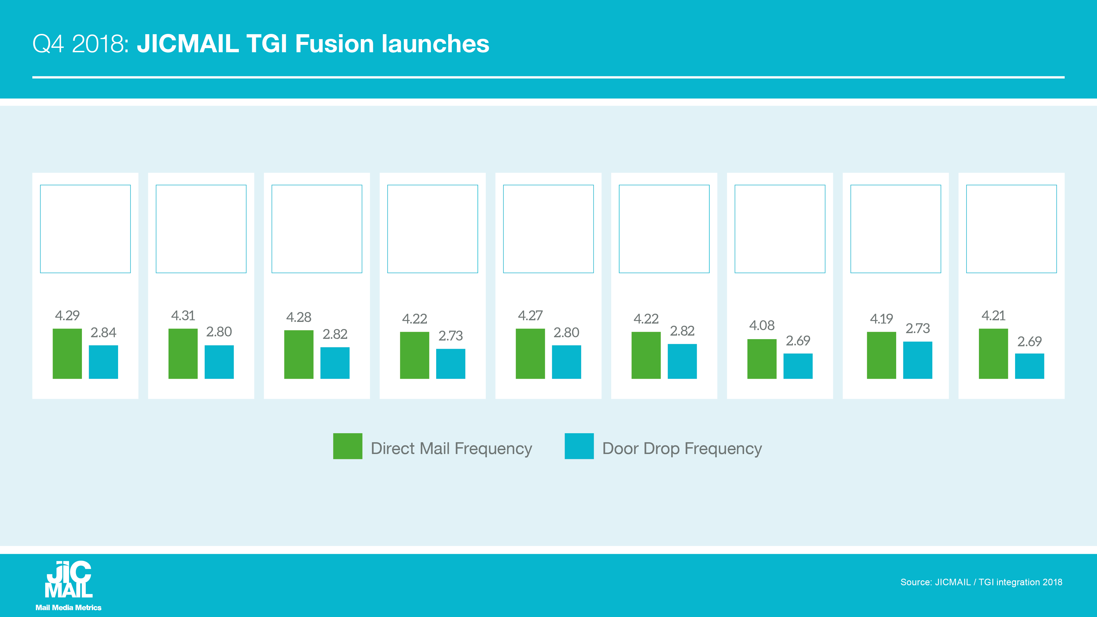

Slide 36
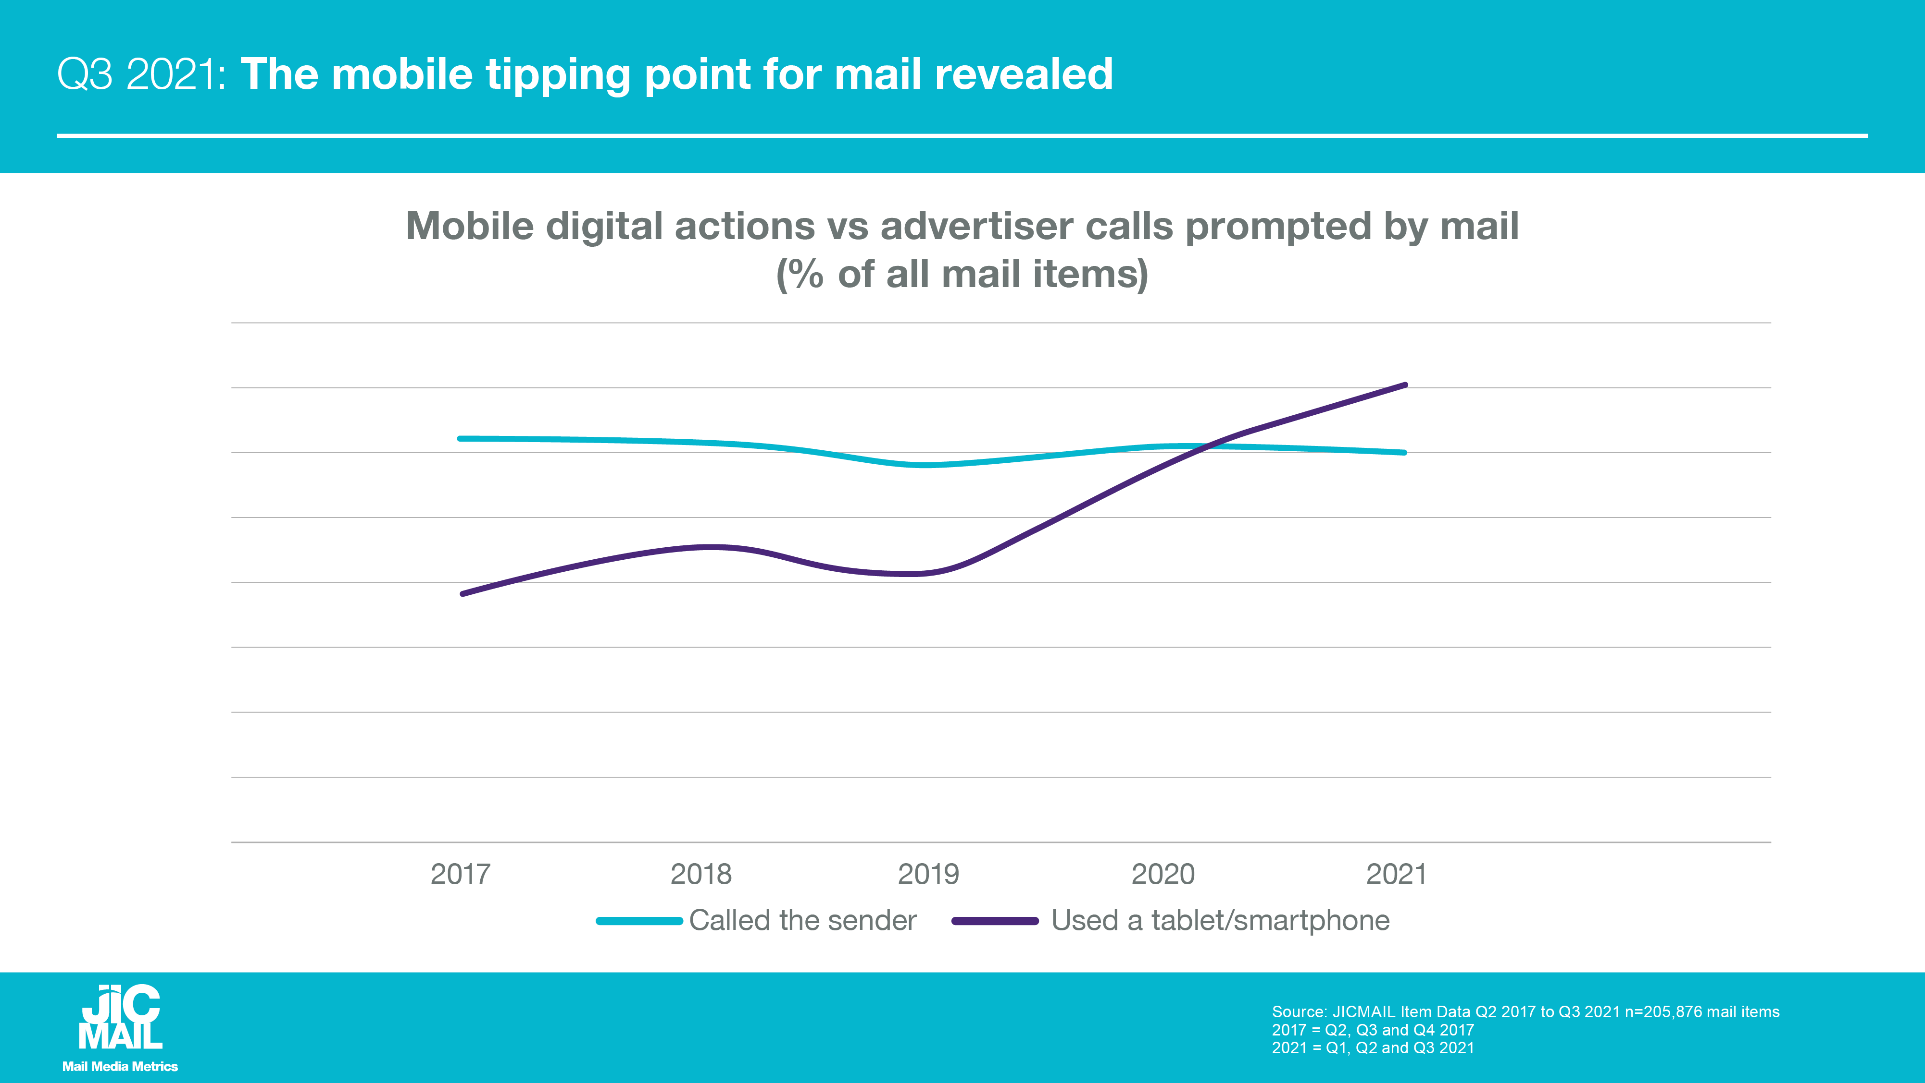

Slide 39
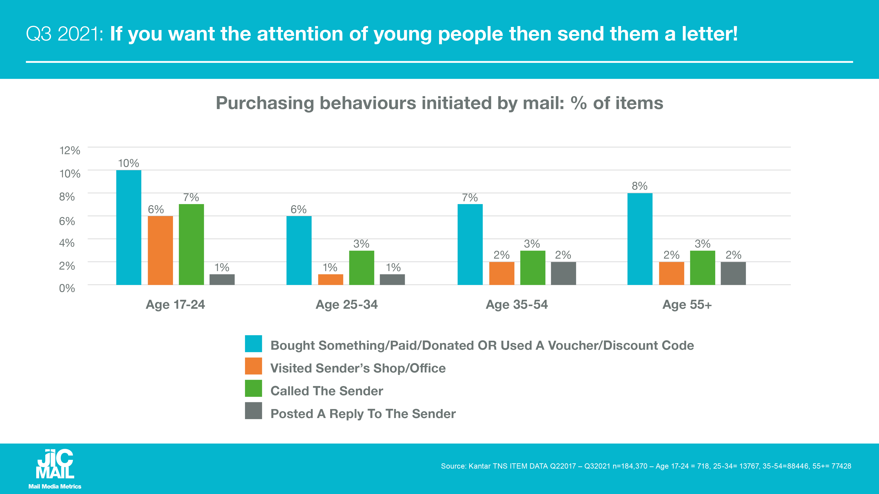

Slide 40
